Slide 1

Credit EDA Case Study
-Deepak and Komal

Slide 2
Problem Statement
This is achieved by using EDA (Exploratory data analysis) on the bank data, wherein we analyse the pattern present in data and help bank in mitigating two types of risk associated with loan approvals:- If the applicant is likely to repay the loan, then not approving the loan results in a loss of business to the company .If the applicant is not likely to repay the loan, i.e. he/she is likely to default, then approving the loan may lead to a financial loss for the company
When a client applies for a loan, there are four types of decisions that could be taken by the client/company):
Approved: The Company has approved loan Application
Cancelled: The client cancelled the application sometime during approval. Either the client changed her/his mind about the loan or in some cases due to a higher risk of the client he received worse pricing which he did not want.
Refused: The company had rejected the loan (because the client does not meet their requirements etc.).
Unused offer: Loan has been cancelled by the client but on different stages of the process.

Slide 3
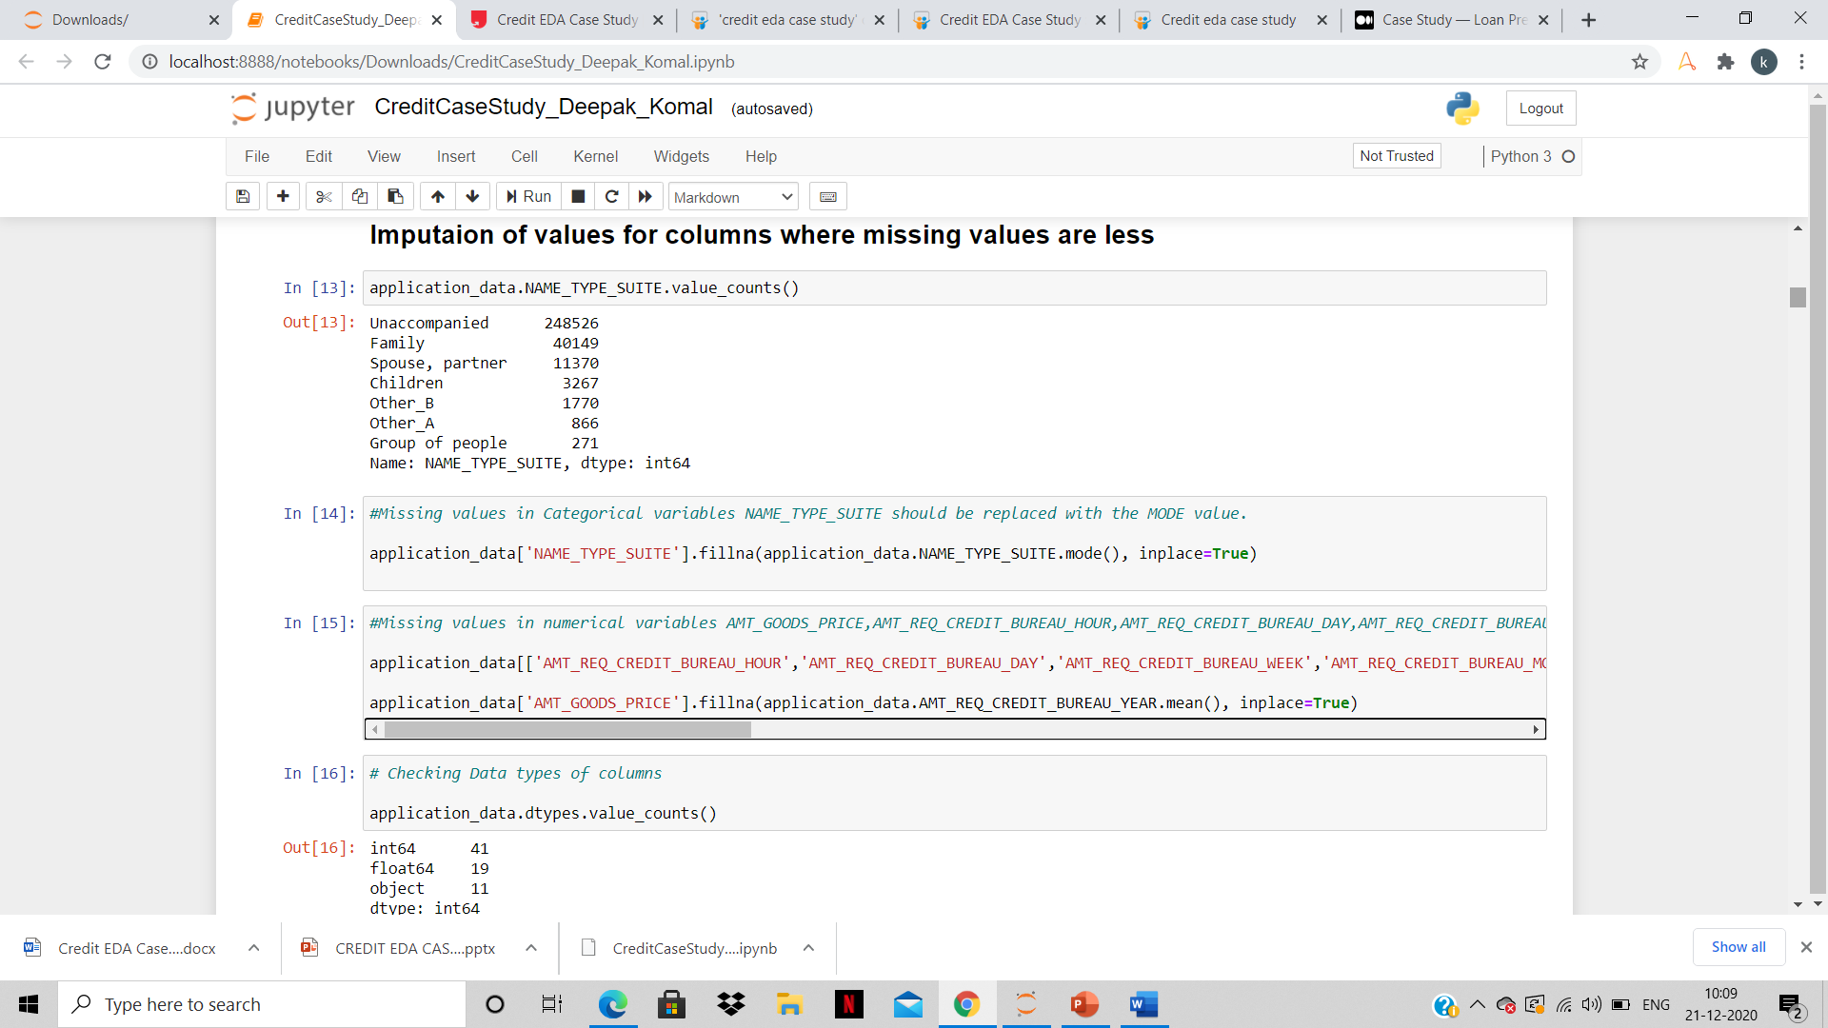
Removal of missing Values
In EDA , we remove missing values so that analysis can be done on corrected data . After identifying missing values- we have handled them by replacing other values.

Slide 4
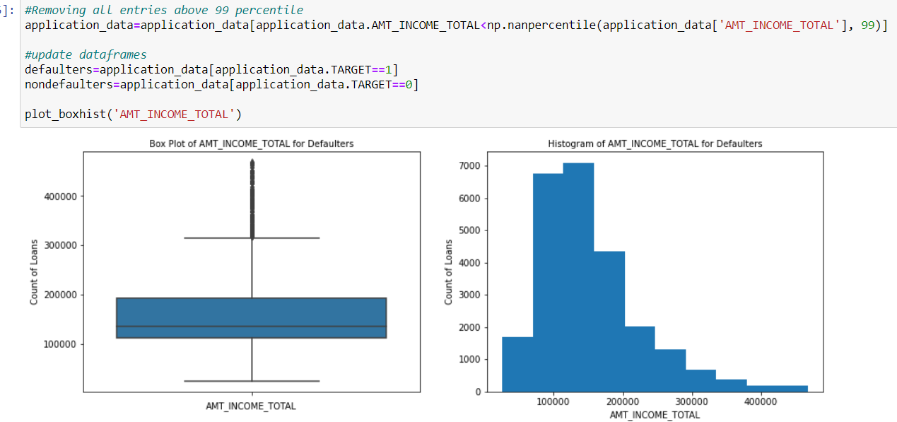
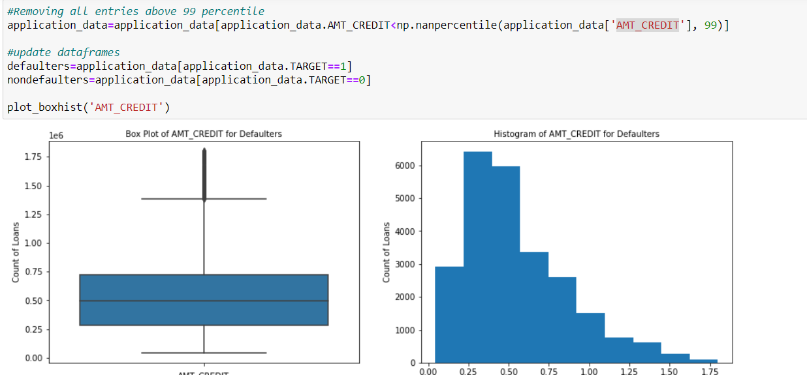
Identifying Outliers
We checked for Target Variable(==1 or ==0 ) for identifying Defaulter and Non defaulter.
Checking on columns such as 'AMT_INCOME_TOTAL’
We see that the Annuity amount lies between 15000 to
around 30000 for defaulters
B) AMT_CREDIT

Slide 5
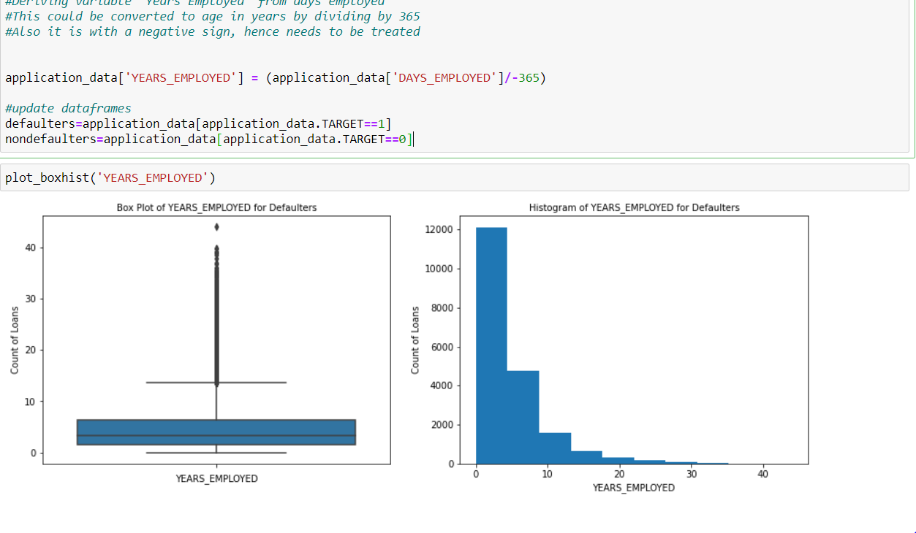
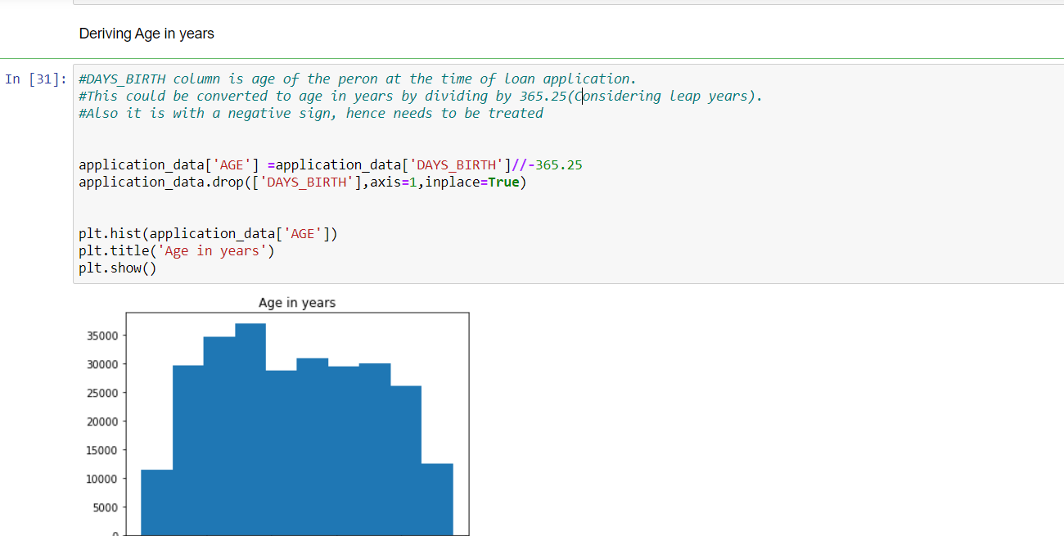
Identifying Outliers
c) YEARS_EMPLOYED
D) DAYS_BIRTH column is age of the peron at the time of loan application.
#This could be converted to age in years by dividing by 365.25(Considering leap years).
#Also it is with a negative sign, hence needs to be treated

Slide 6
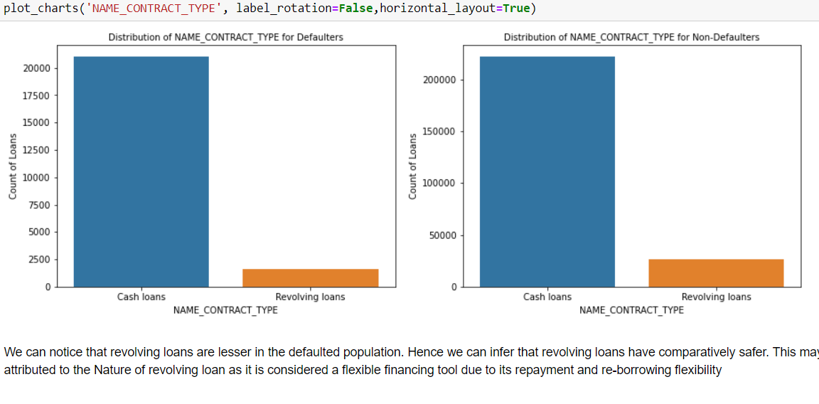
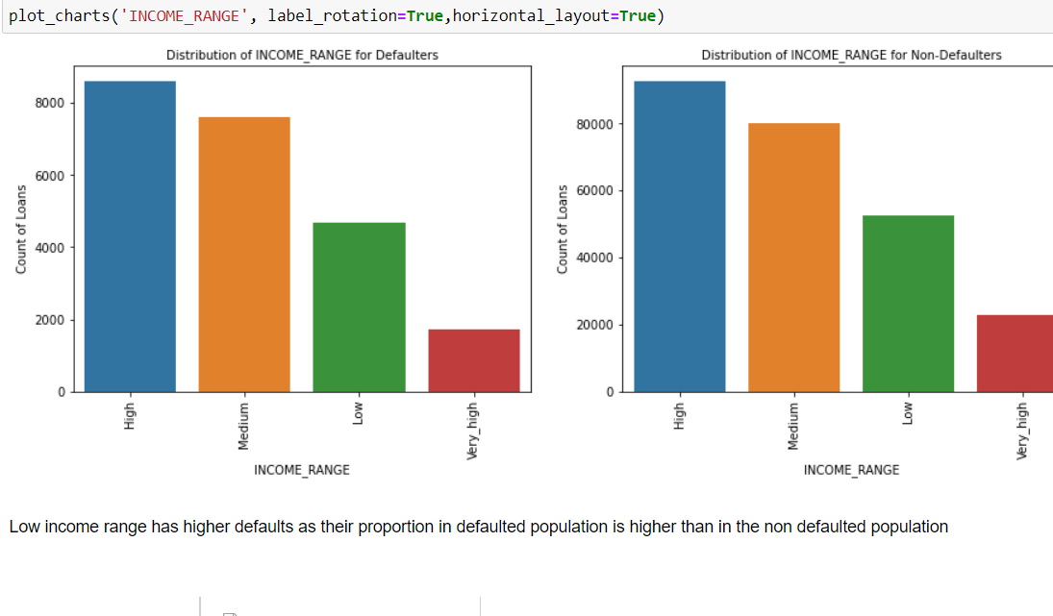
Checking conditions for Defaulter and Non Defaulter
It will be used to analyse and compare the data between defaulter and Non defaulter.
We will group the data on basis of age group ,amount , income Tax . Other factors like whether individual owns a Car ,Live in which type of City ,Type of House they own ,Income Range ,Education Type . Then a comparative analysis will be done to check and compare the data

Slide 7
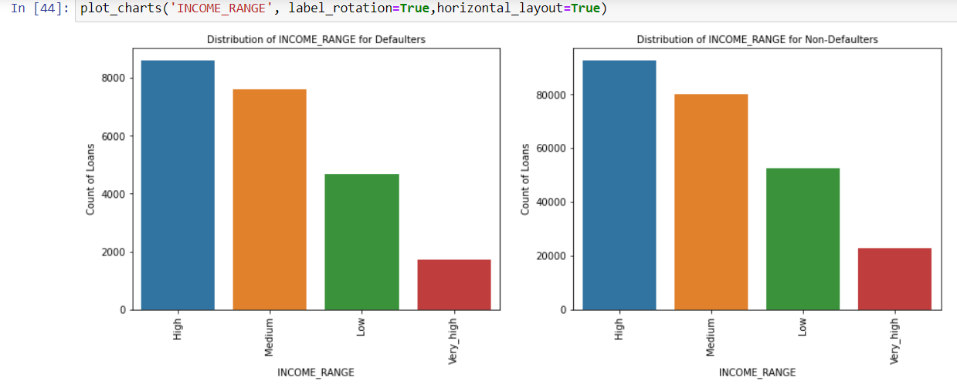
Checking Variables among Defaulters and Non Defaulters
Analysis of Income Variable for Defaulter and Non Defaulter(A large number of non-defaulters have very high income)

Slide 8
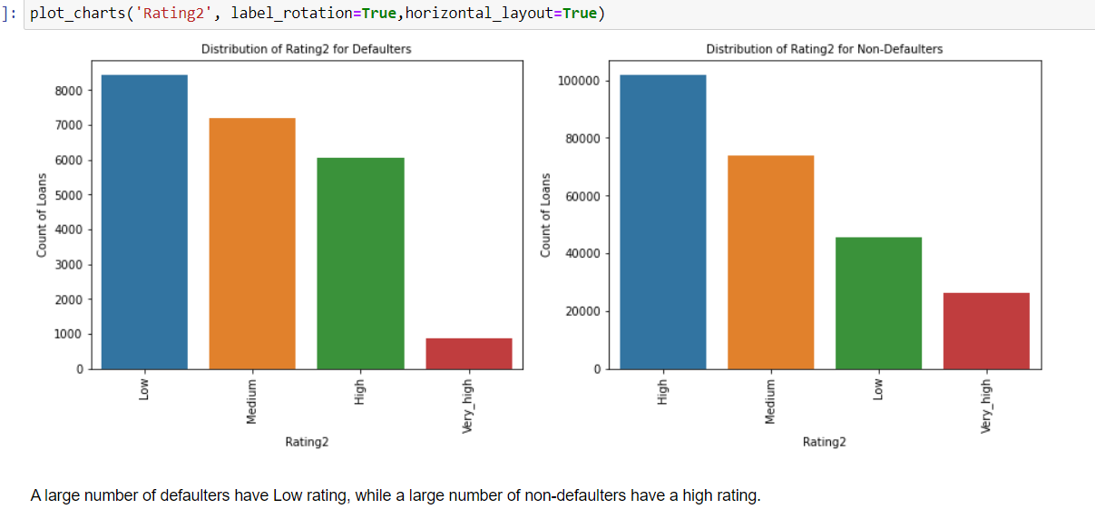
Checking Variables among Defaulters and Non Defaulters
Analysis of Rating among Defaulter and Non Defaulter

Slide 9
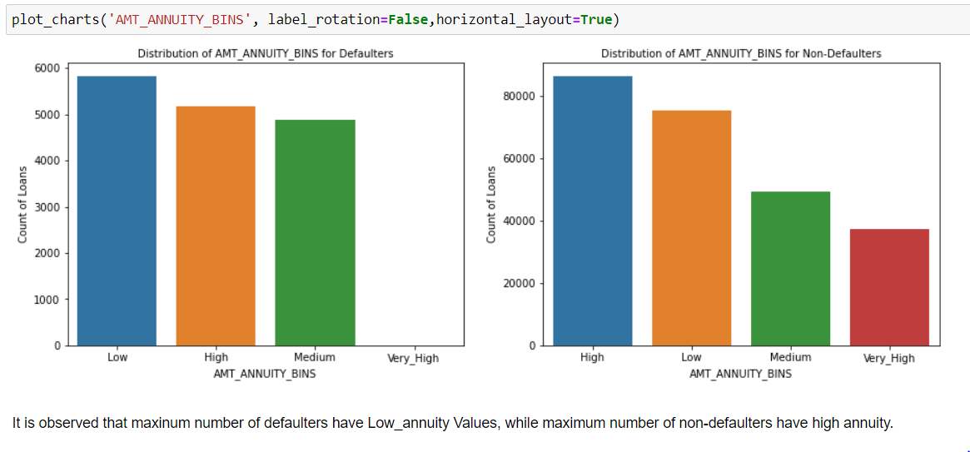
Checking Variables among Defaulters and Non Defaulters
Analysis of Amt_Annuity_Bins among Defaulter and Non Defaulter

Slide 10
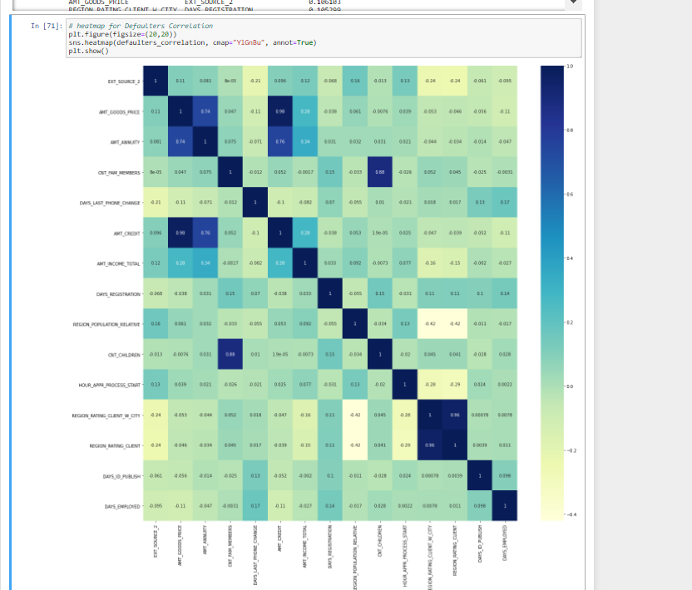
Heat Map for Defaulters

Slide 11
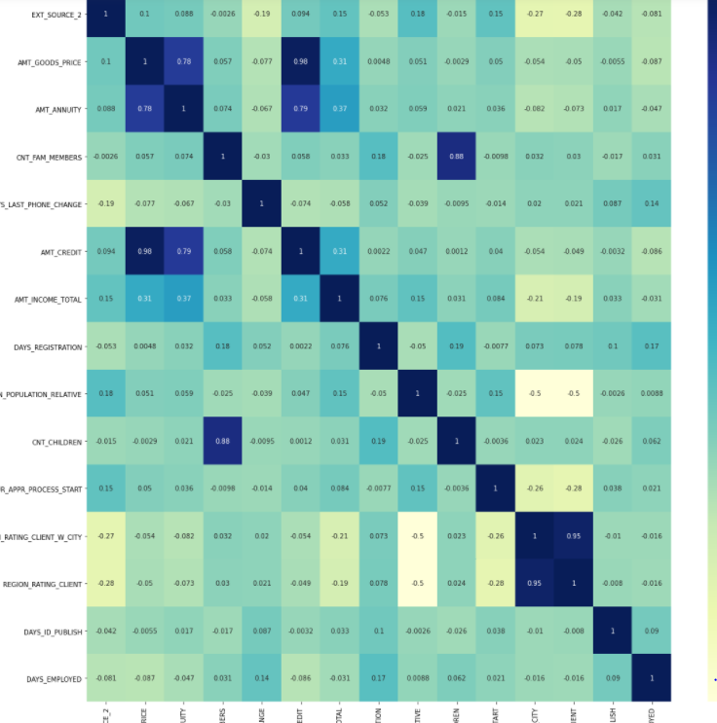
Heat Map for Non Defaulters

Slide 12
Correlation for Defaulters and Non Defaulters
Most positive correlations are as below:
OBS_30_CNT_SOCIAL_CIRCLE- OBS_60_CNT_SOCIAL_CIRCLE
AMT_GOODS_PRICE- AMT_CREDIT
REGION_RATING_CLIENT_W_CITY- REGION_RATING_CLIENT
CNT_FAM_MEMBERS- CNT_CHILDREN
DEF_60_CNT_SOCIAL_CIRCLE- DEF_30_CNT_SOCIAL_CIRCLE
AMT_CREDIT- AMT_ANNUITY
AMT_ANNUITY- AMT_GOODS_PRICE
EXT_SOURCE_1- AGE
REGION_POPULATION_RELATIVE- REGION_RATING_CLIENT_W_CITY
REGION_RATING_CLIENT- REGION_POPULATION_RELATIVE
Most negative correlations are as below;
HOUR_APPR_PROCESS_START - REGION_RATING_CLIENT_W_CITY
REGION_RATING_CLIENT - HOUR_APPR_PROCESS_START
REGION_POPULATION_RELATIVE - REGION_RATING_CLIENT
REGION_RATING_CLIENT_W_CITY - REGION_POPULATION_RELATIVE

Slide 13
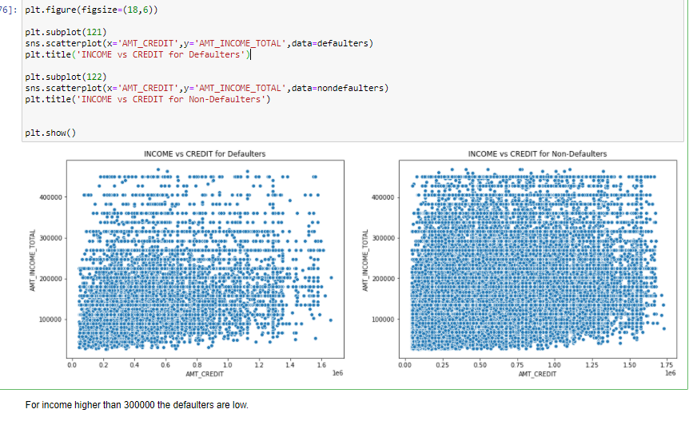
Checking Numerical Variables for both defaulter and non Defaulter
A) Income VS Credit(For income higher than 300000 the defaulters are low.)

Slide 14
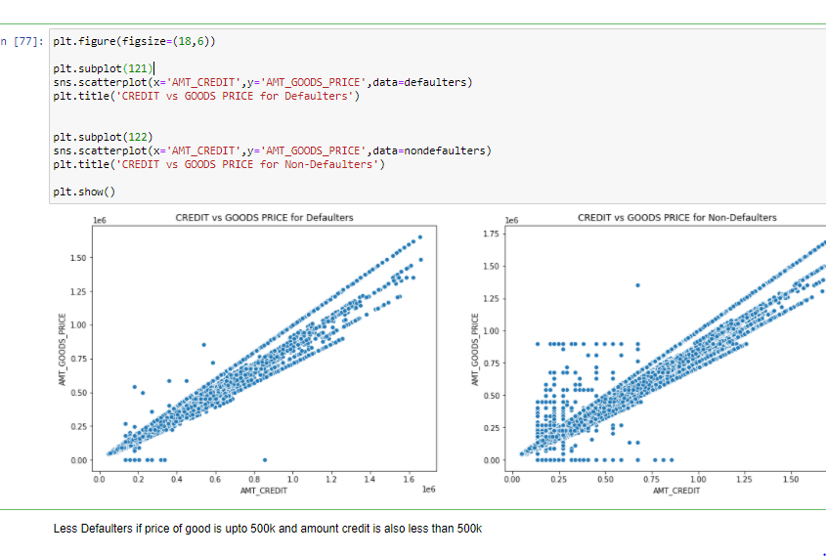
Checking Numerical Variables for both defaulter and non Defaulter
A) Good_price VS Amt_Credit(Less Defaulters if price of good is upto 500k and amount credit is also less than 500k)

Slide 15
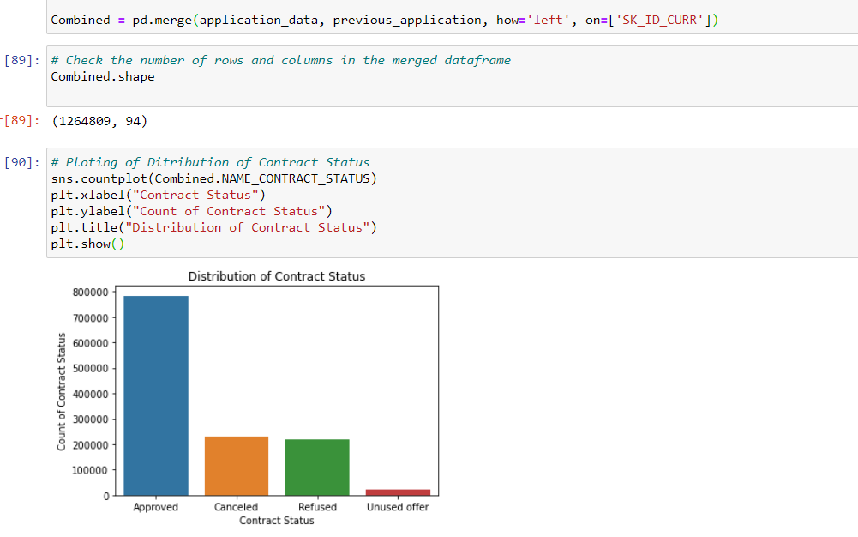
Analysis of Previous application Dataset
We will merge the previous and new application data set and then we will analyze the variables

Slide 16
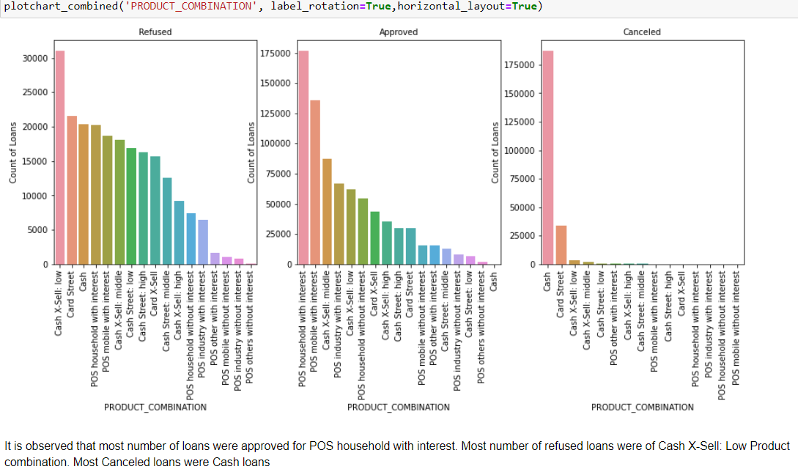
Product Combination Vs Status

Slide 17
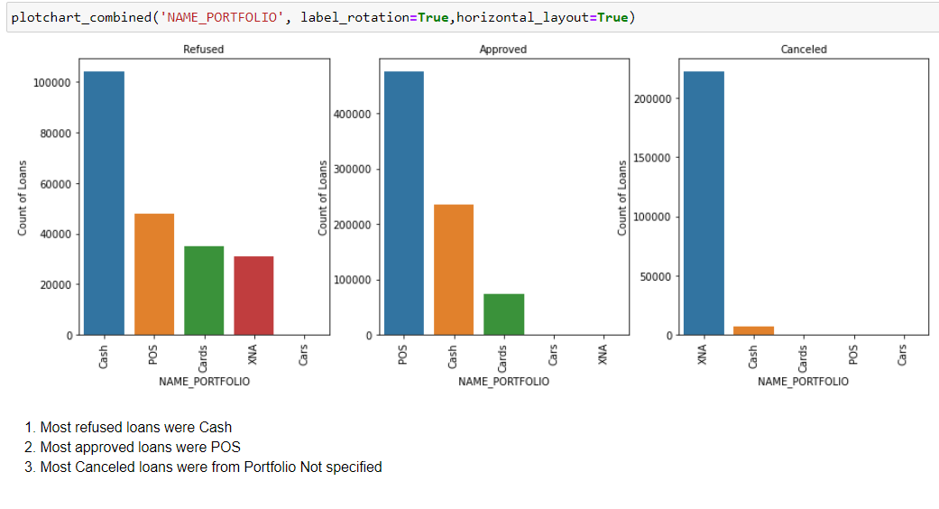
Name Portfolio Vs Status

Slide 18
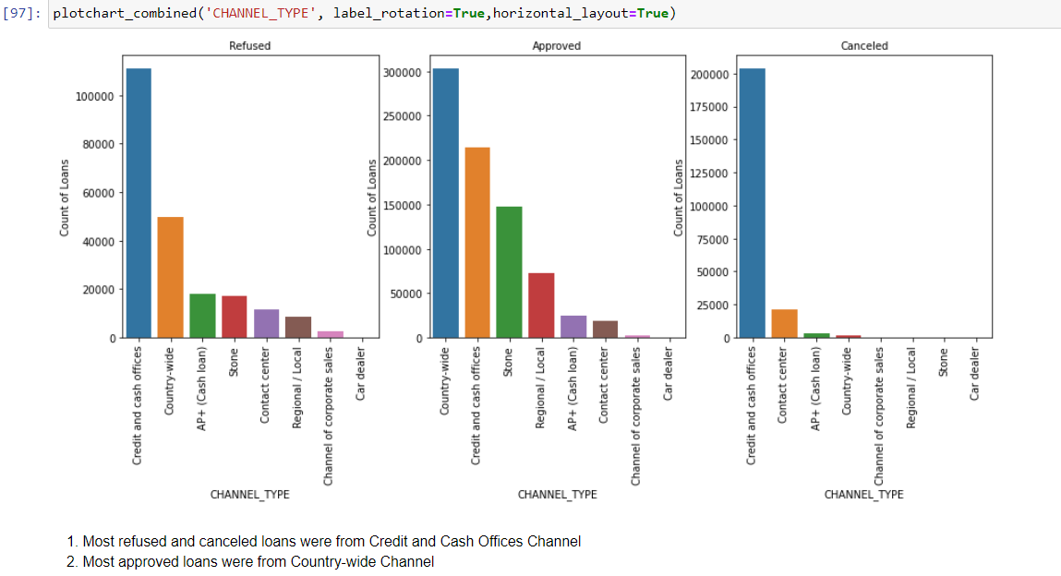
Channel Type Vs status

Slide 19
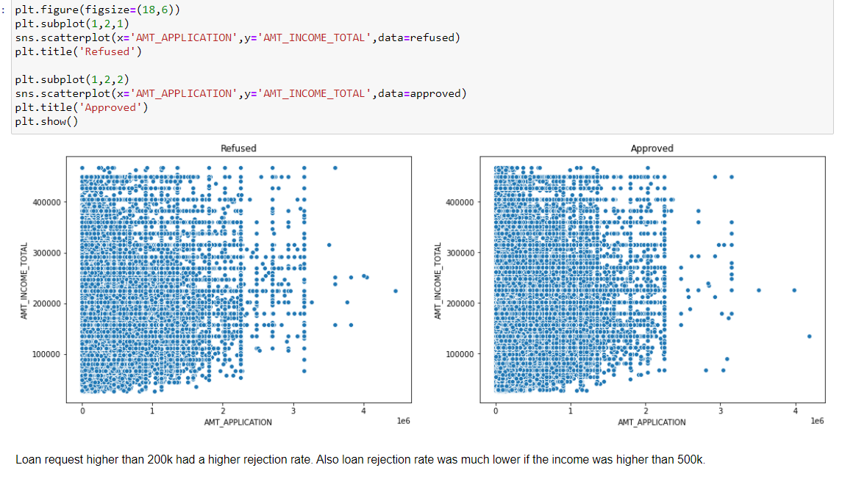
Amount Vs Status

Slide 20
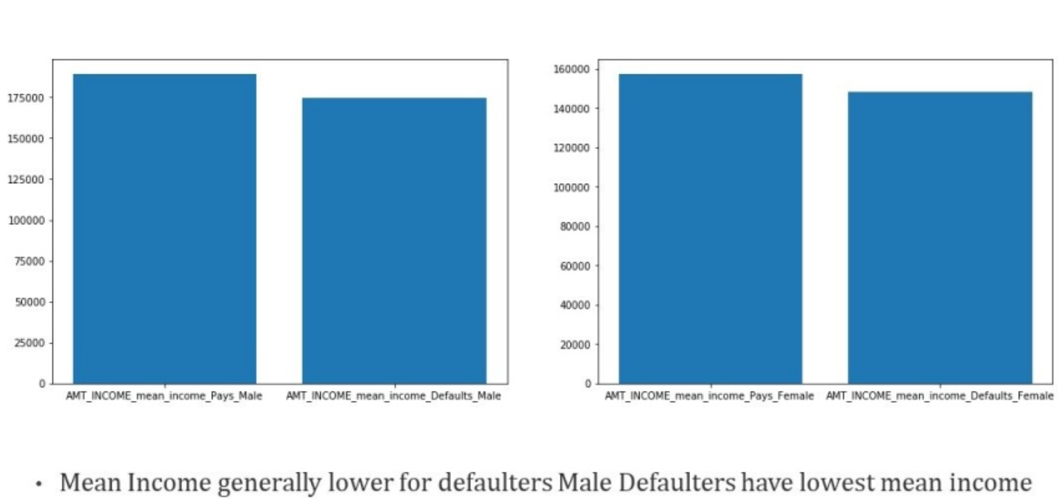
Defaulter Income

Slide 21
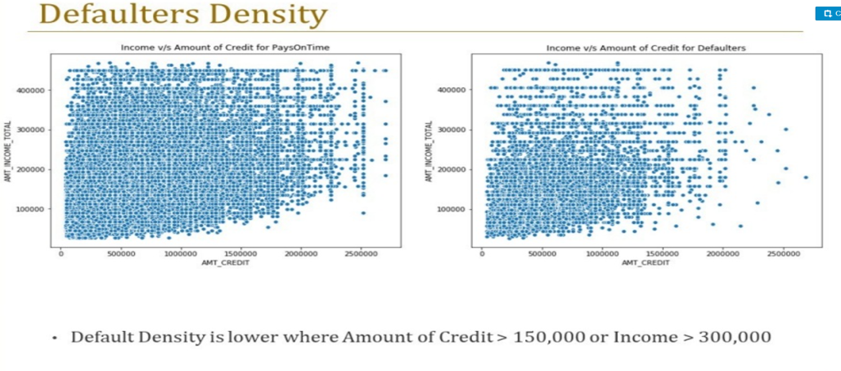
Defaulter Income

Slide 22
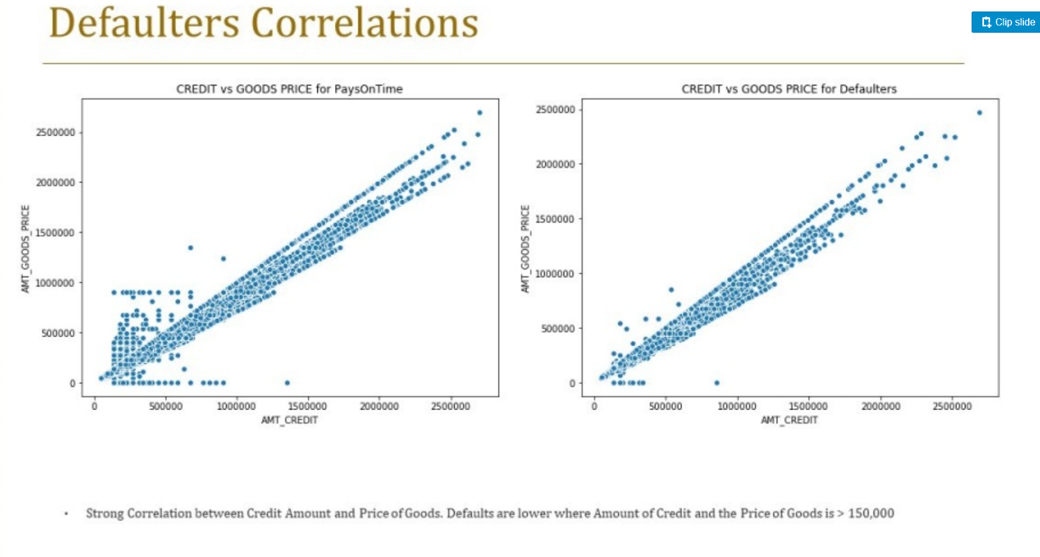
Defaulter Correlation

Slide 23
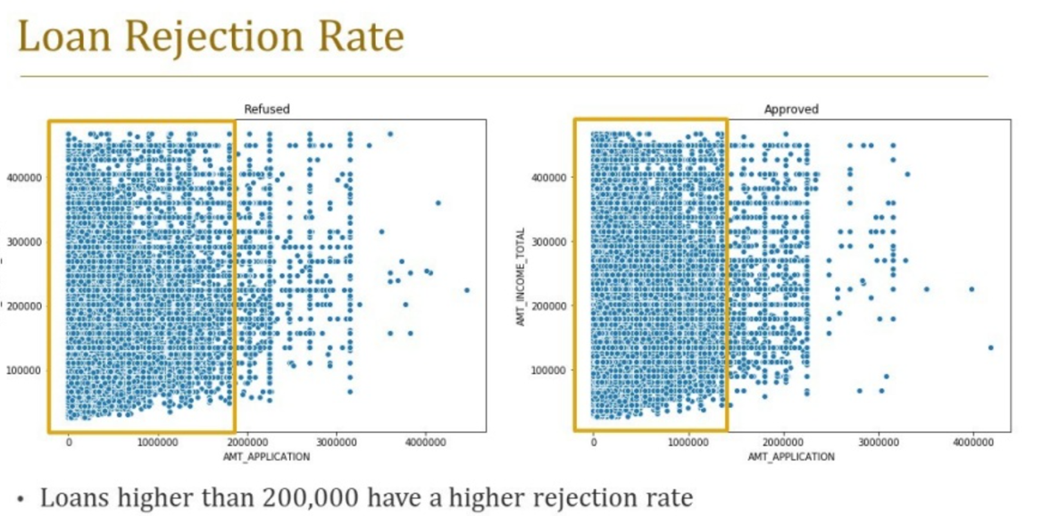
Loan Rejection Rate

Slide 24
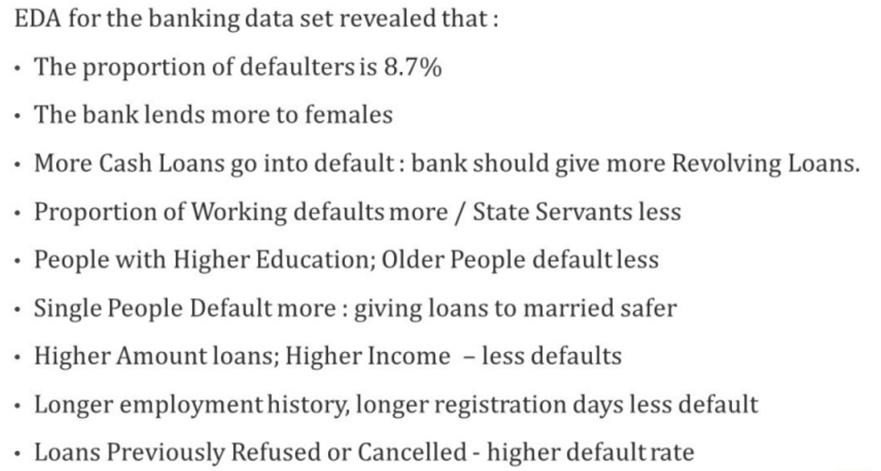
EDA Analysis

